Slide 1


Making markets work for HIV prevention: A total market approach to condom security in Vietnam
Dr. Kimberly Green, PATH; kgreen@path.org
Authors: Vu Hai Yen, PATH; Kimberly Green, PATH; Ngo Minh Trang, USAID; Chieu Van Vu, VAAC/MOH; Tran Hung Minh, CCIHP; Trang Thu Quach; CCIHP; Doan Thanh Tung, Lighthouse Social Enterprise, Thanh Le, G-link Social Enterprise; Son Le, G3VN Social Enterprise

Slide 2
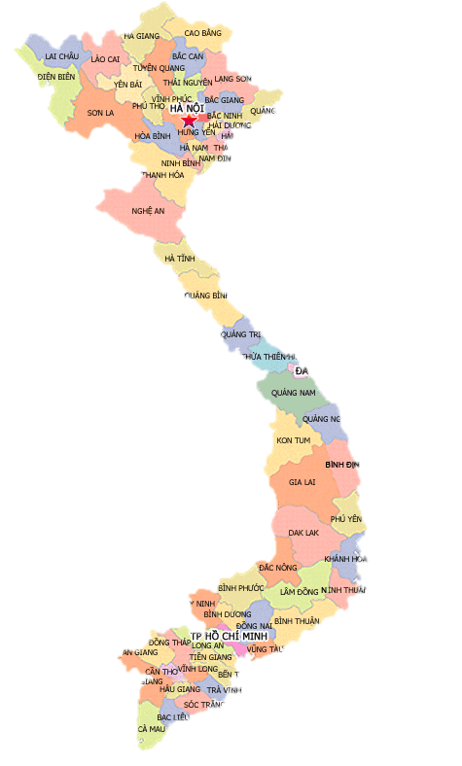

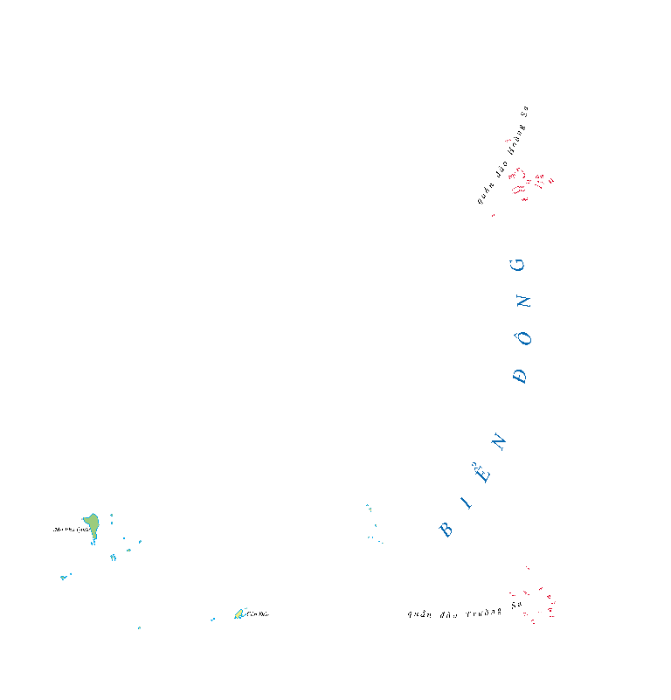
  Vietnam was at a crossroads in 2014
  HIV epidemic concentrated in key populations; dynamic epidemic
  MoH committed to 90-90-90 by 2020, and elimination of HIV by 2030
  But, 77% of the national HIV program was donor funded, and…
  With Vietnam attaining lower middle income status, major donors have left or dramatically reduced size and geographic scope
Source: MOH. 90-90-90 report, December 2014. MOH. National Health Account, VAAC/MoH 2015; Viet Nam AEM, 2014

Slide 3

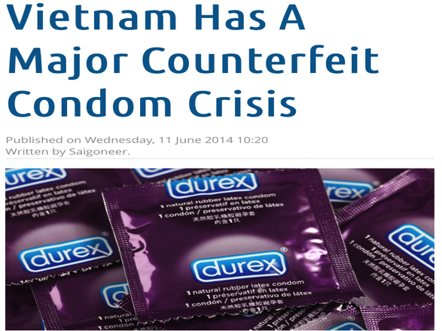
There was both
  Good news…
  With reduction of free/partially subsidized condoms, incentive for local condom manufacturers to produce for the local market
  Increasing purchasing power, and willingness/ preference to pay
  And not so good news…
  Lack of government awareness of the total market approach (TMA)
  Condom market was unregulated, no mandatory standards, abundance of low quality and fake products
Source: UNFPA 2014
Notes:
With attaining economic success and middle income status
Major transition from external financial support to local financing underway. With redu external donor resources TMA helps to reduce procurement pressures/expenses, focusing finite public resources on meeting needs of most vulnerable populations
Key questions
As volume of high quality free and partially-subsidized condom product declines, and commercial condoms dominate how to?
How will key populations access condoms? What brands appeal to them, and at the right price points?
256,000 people living with HIV in Viet Nam
Epidemics of concern among MSM, TGW in urban areas; and PWID and female partners in select districts/provices.
MoH led; PEPFAR played major role in this success.
Middle income - $3,620 (above 3,000 GDP per capita)

Slide 4
From 32-50% of the market represented free or socially marketed condoms

Slide 5
  How to address market gaps and sustain key population access to quality & affordable condoms?

Slide 6

USAID/PATH Healthy Markets: Towards a sustainble HIV response
GOAL
Grow a viable commercial market for HIV-related commodities and services
Objective 3
Increase Private Sector
SUPPLY of HIV Commodities and Services
Objective 1
Increase Local and
Private Sector
INVESTMENT
Objective 2
Increase DEMAND for HIV Commodities and Services
Technical assistance and capacity strengthening applied across all objectives
Commodities: Condoms, Lubricant, LDSS, RDTs
Services: HIV testing, PrEP, nPEP, ART++

Slide 7

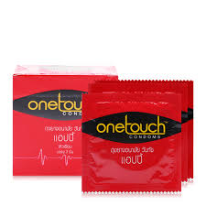

6 steps towards condom market development
6
5
Assist MOH with TMA planning & budgeting (calculator)
4
Advocate for condom quality assurance standards
3
2
Boost and sustain demand
Build partnership with private sector value chain
1
Segment consumer preferences, willingness-
to-pay
Generate evidence and insights (policy, market, consumer)
Free distribution
2004-2008
Social Marketing
2008-2013
Commercialization
Since 2014
Notes:
What condoms appeal? What price point?

Slide 8
Willingness to pay: Price point for one condom
Commercial condom price range*
Low end: 1,700 dong (7 cents) per piece
Medium end: 3,000 (13 cents)
High end: 5,420 (24 cents)
Source: PATH/USAID Healthy Markets. Market Research on HIV Commodities & Services: Consumer Survey, 2015 ; *Condom market in Vietnam, IMS 2014

Slide 9




Developing a local commercial condom supply chain
Example: Gallant distribution system for KP and wider market
Medevice3s
Gallant
Distributor
DUMIYO
(24 provinces)
Hotel/guesthouse
Pharmacies
CBOs/social enterprises
(28 in 10 provinces)
Supermarket
Key population client
Pharmacies/
HIV Hotpots
Online
General market
KP-focused
“Our clients like our products and are willing to pay. With technical assistance, we are now a profitable business and can sustain and grow”. Nguyen Minh Hieu, Director, Social Enterprise Nu Cuoi
Notes:
Marketing TA

Slide 10





Condom promotion…

Slide 11
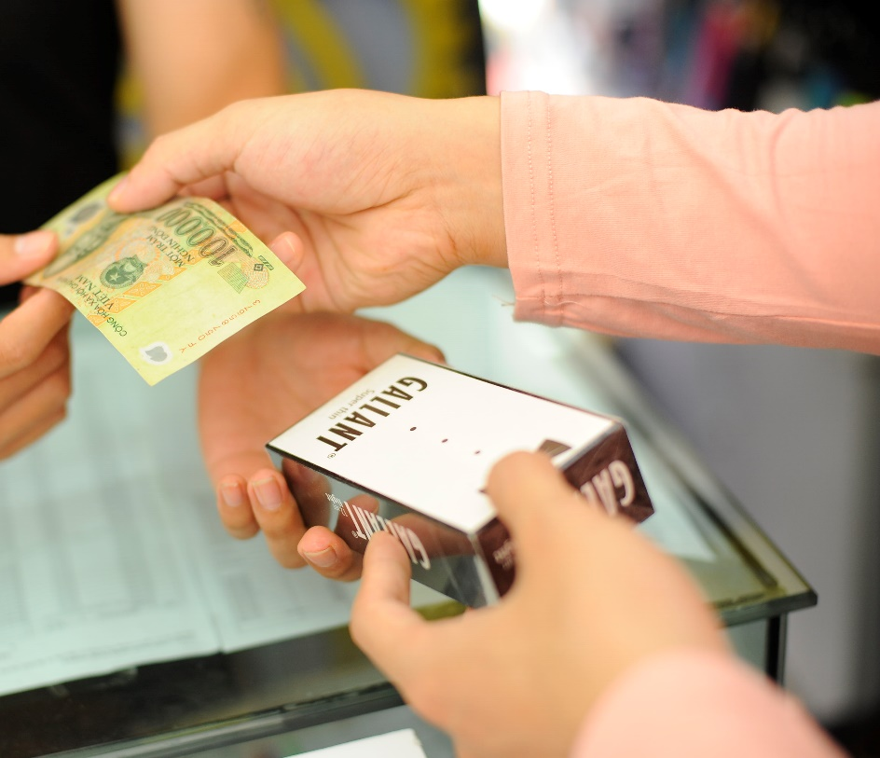
Key results

Slide 12
Growth in KP-focused condom sales
KP-focused condom sales: 2015-2017
260%
215%
*Sales in 15 provinces
“Gallant is becoming really popular in the MSM community—it fits with our style. The design is really nice and modern, which is what MSM want, but it’s also a good quality product. The super thin version especially appeals to MSM.”
- Doan Thanh Tung, head of Hanoi-based civil society organization, Lighthouse

Slide 13
Shift from social marketed to commercial
condoms in non-traditional outlets…
Non-traditional outlet condom sales, 2010 - 2016
Source: USAID/PATH Healthy Markets. Non-traditional outlet condom coverage and type report, 2016; PSI NTO condom assessments, 2010, 2012, 2013. *Repeated measure in 6+ provinces

Slide 14
Growth in private sector investment in the local condom market

Slide 15
Stabilizing market…

Slide 16
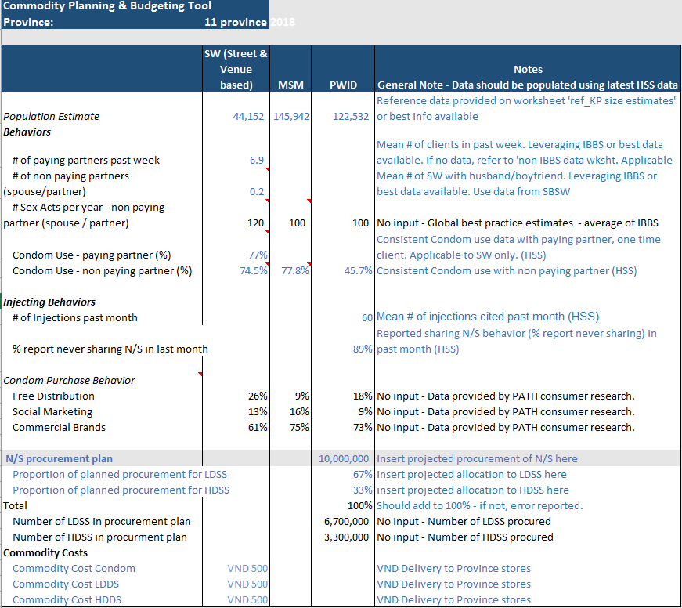
Condom quality and national tools for commodity estimations and budgeting
MOH TMA commodity calculator formally adopted as part of annual HIV program planning to assist provinces and MOH with financing of commodities for those not able to pay
Mandatory condom quality standards approved by MOH in April 2017

Slide 17
Key takeaways
Generating market and consumer insights and brokering relationships with new distributors and retailers were invaluable to encouraging local condom manufacturers to invest in the local market
Increasing the capabilities of KP-led CBOs and social enterprises to engage in commercial condom sales was essential to developing a sustainable KP-focused market
Partnering closely with the MOH from the start increased their ownership and stewardship of more nuanced condom (and other HIV) commodity planning
“TMA is a new and innovative response to HIV in Vietnam. The approach is a valuable planning and budgeting tool to segment populations and better target finite resources. As external donor funding declines, we are committed to collaborating with new partners to increase access to HIV prevention commodities, growing the market in a responsible and sustainable way.”
- Dr. Vu Van Chieu, Vice Chief of the General Planning Department, Vietnam Authority of HIV/AIDS Control

Slide 18
Conclusions
The total market approach has been a driving force for growing a sustainable condom market that meets the needs of key populations in Vietnam.
Learnings from the condom market are now being applied to needles and syringes, lubricant and HIV self-test kits to develop and grow those markets.
To further sustain private sector engagement, the MOH will need to continue to develop as a market manager

Slide 19

Acknowledgements
CBOs/Social enterprises: Lighthouse, G-Link, G3VN, Aloboy, M4M, Color of Life, Vuot Song, Smile, V-Smile, SHP, Kid’s Sun, Love Boy, Suc Moi, Song Tre, Niem Tin Xanh, I Girls, We are Students
MoH/VAAC: Assoc. Prof Dr. Nguyen Hoang Long, Dr. Phan Thi Thu Hung, Dr. Pham Duc Manh, Dr. Hoang Dinh Canh
Ho Chi Minh City PAC: Dr. Tieu Thi Thu Van; Hanoi PMC: Dr. La Thi Lan
USAID Vietnam: Ms. Ngo Minh Trang, Ms. Nguyen Thi Minh Huong, Dr. John Eyres, Ms. Mei Mei Peng
Private sector: Medevice 3s, Dongkuk, Vietnam Rubber Trade, One Touch, Dumiyo++
PATH: Dr. Johannes van Dam, Vu Hai Yen, Bao Ngoc Vu, Tham Thi Tran, Mr. Nguyen Viet Dung

